Slide 1
R.A.W.
Remote Armwrestling
SDP Team 12
Tyler Costa, Steve Lucey, Zach Matthews, Steve McGrath
Notes:
Steve L.

Slide 2
Problem Statement
A game that connects the physical and virtual world
Physical competition between distant friends
More intimate than phone call
Could motivate individual to exercise (strength training)
Notes:
Steve L.
If friends plan to meet at bar with RAW at end of week, more likely to work out that week.
https://www.google.com/url?sa=i&rct=j&q=&esrc=s&source=images&cd=&cad=rja&uact=8&ved=0ahUKEwi3xfTA5PbWAhWLPCYKHbgsCiMQjRwIBw&url=https%3A%2F%2Fwww.pinterest.com%2Fpin%2F164381455119064701%2F&psig=AOvVaw0vlvB1OXIHQGuxyQWCiMzB&ust=1508299652782709

Slide 3
The Product
Remote ArmWrestling game against other users in real-time
Two robotic arms connected over the internet
Each arm replicates the force and strength of the opposite user
The results of the matches would get submitted into a database which would rank users based on their performances
Information accessible through phone application
Notes:
Steve L.

Slide 4
System Requirements
A sturdy robotic arm
Average forearm and length being 0.2921 meters
Torque sensing/replication
Torque Constant: 0.209 Nm/A
High speed connection for communicating between arms
Operates with non-perceivable delay
An application for creating an account and monitoring results
Safety function to seize up the arm
Notes:
Zach

Slide 5
Old Block Diagram
Robotic Arm
Application
Power Supply
Motor System
System Padding
GUI
Server/Client
Arm Motion Replication
Database
Pressure Sensing
Force Replication
Feedback Loop
Networking
Maroon - Zach
Green - Tyler
Yellow - Steve L.
Blue - Steve M.
Safety
Microcontroller
Raspberry Pi
Emergency Stop
Arduino
High Speed Connection
Notes:
Tyler

Slide 6
New Block Diagram
To other arm
Robotic Arm
Networking
Application
Arm Design
Video Feed
GUI
Gear Train
Motor Control
Match
Info.
Client/
Server
Raspberry Pi
Safety
Database
Match Data
Arm Power
Hard Stop Bracket
Emergency Stop
Microcontroller
Stop Signal
Arduino
Maroon - Zach
Green - Tyler
Yellow - Steve L.
Blue - Steve M.
Sensors
Current Sensor
Strain Gauge
Current Sensor
Strain Gauges
Feedback
Notes:
Tyler

Slide 7
Proposed MDR Deliverables
1 Arm with Basic Movement Capabilities:
Starts in armwrestling position
Can move corresponding to given human input
Resist motion +/- 5 degrees of starting position
Not networked
Application:
Will have basic GUI with simulated functionality
Local database
Notes:
Steve M

Slide 8
Actual MDR Deliverables
1 Arm with Basic Movement Capabilities:
Starts in armwrestling position
Arm begins to lose to given amount of weight
Arm then stalls and stops losing to the given amount of weight
Finally, arm starts beating given amount of weight
Not networked
Application:
Android application
Local SQLite database
Notes:
Steve M

Slide 9
Each Member's Contribution for MDR
Tyler Costa: Lower arm design, Gear train, and Motor Control
Steve Lucey: GUI/Client for Matches, Arduino IDE functions
Zach Matthews: SQLite Database, GUI/Client for: Create/Edit/View Profile, Follow/Unfollow Users, Join Followings’ Matches
Steve McGrath: Upper arm design and Strain gauges
Notes:
Steve M

Slide 10
Application
Capabilities
Create/view/edit profile
Schedule/join matches
Follow other users
Microsoft Visual Studio
Xamarin developer for Android
Coded in C#
Android Debugging
Helped find errors
Found multiple runtime errors
Notes:
Zach

Slide 11
Application Clarifications
Local database (as promised) will be uploaded to server
Arm’s currently numbered but will be geographically selectable
Currently no notifications
Matches
Followings
Notes:
Steve L

Slide 12
Arduino
Made multiple functions in Arduino IDE
motorCurrent function
Finds instantaneous motor current
desiredCurrent function
Calculates Current to match force applied on the forearm
dutyCycle function
Provides desired duty cycle according to desired current
Notes:
Steve L

Slide 13
Transition
To
SDP Lab

Slide 14
Arm Design
Amp Flow E50-150 Brushed DC Motor
24 VDC 5000 RPM
1:77.76 Gear ratio
3 stages
Limited elbow flexibility
70 degrees to 110 degrees
Aluminum beam connected to end of drive shaft to represent forearm
Notes:
Tyler

Slide 15
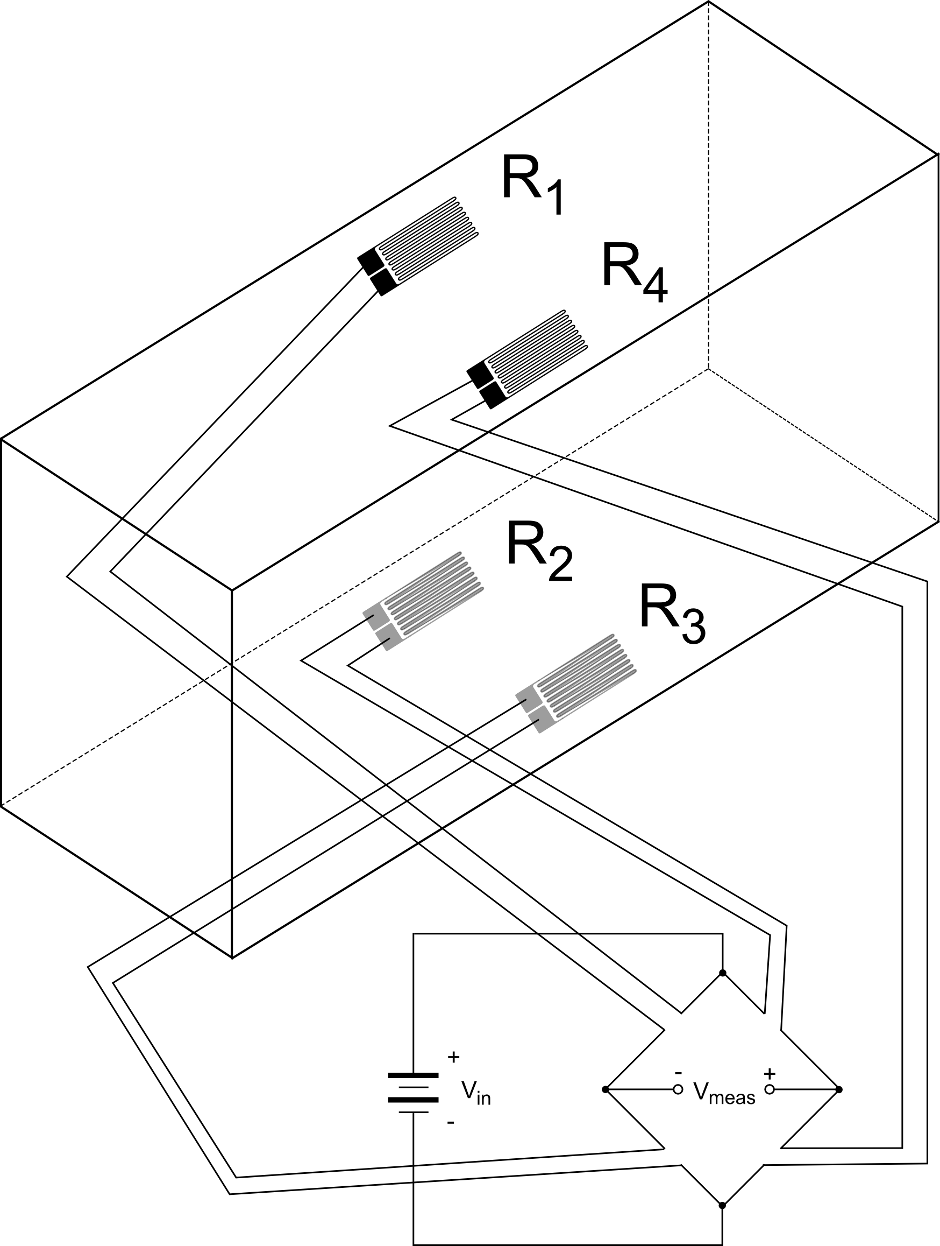
Sensors (Strain Gauges)
Strain gauges mounted in full wheatstone bridge configuration
Provides voltage differential
Voltage differential corresponds to force/torque applied
Torque = force * distance to pivot
Desired current calculated through torque constant (Nm/A)
http://www.continuummechanics.org/images/straingauges/full_bridge_bending_circuit.png
Notes:
Steve M

Slide 16
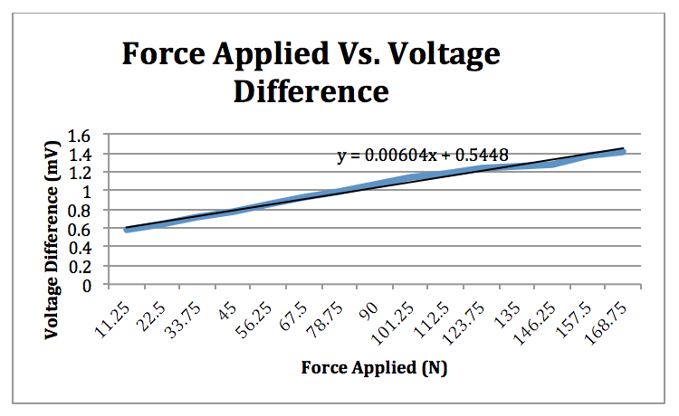
Strain Gauges Force Replication
Force (N) | Voltage Difference (mV)
11.25 | .475
22.5 | .538
33.75 | .608
45 | .679
56.75 | .748
Notes:
Steve M

Slide 17
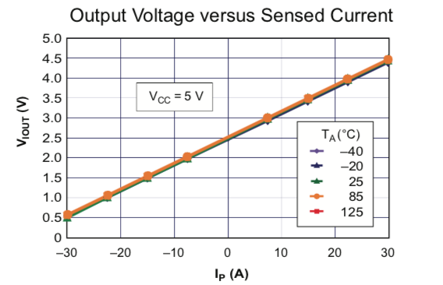
Motor Control
Arduino and Cytron motor driver
Arduino feeds PWM wave with desired duty cycle
Current control to provide desired force/torque
Instantaneous Current feedback to arduino
Adjust duty cycle to source desired current according to corresponding force/torque
Notes:
Tyler

Slide 18
Duty Cycle (0-255) | Current (A) | Output torque (Nm)
14 | 0.41 | 6.57
18 | 0.64 | 9.86
20 | 0.8 | 13.14
22 | 0.9 | 16.43
26 | 1.3 | 19.72
30 | 1.69 | 26.29
34 | 1.96 | 32.86

Slide 19
Proposed CDR
One fully functioning arm with emergency stop mechanism
Arduino’s networked through Raspberry Pi’s
Simulated game sent from Arduino over network to active arm
Second arm built without emergency stop
Simulated Game
Raspberry Pi
Raspberry Pi
Robotic Arm
With Player
Arduino
Arduino
Notes:
Steve L

Slide 20
Gantt Chart
Notes:
Zach

Slide 21
Demo

Slide 22
Questions?

